Slide 1

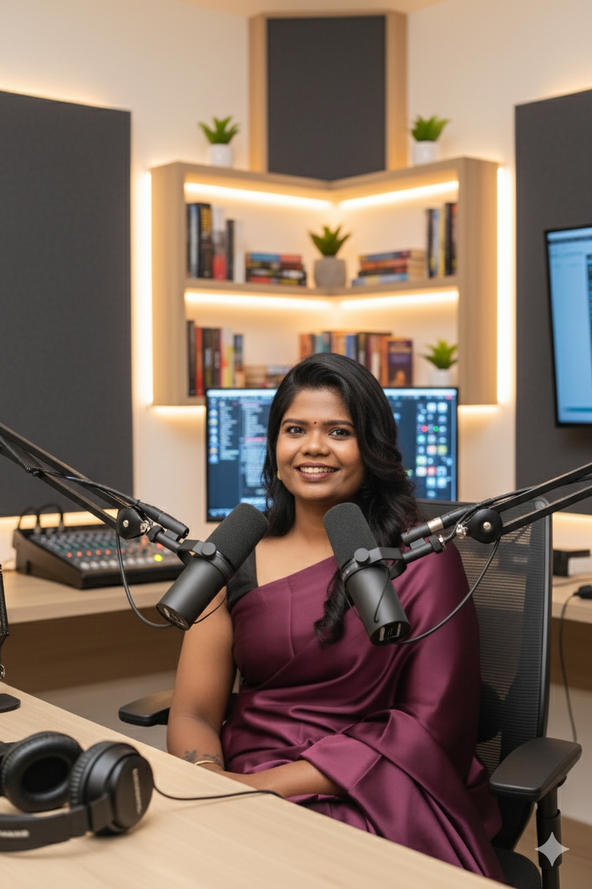
One to One Adult Life Coaching Program
Self-Awareness & Transformation Coach Building Consistency & Resilience Embark on a journey of knowing your Inner Power through cultivating Self-awareness, Mindfulness and transforming you towards building a Rewarding life through Qualities of Consistency, Resilience and Fortitude

Slide 2
How will I help you?
Who will benefit? – To all the middle-aged adults who are going through mid life crisis, who are feeling stuck in life and have limited vision on where they want to reach.
Why now? Many of the adults live a life in “Auto-Pilot” mode and NOT living their life to fullest potential. A quick decision to align their life to their highest purpose will lead to more joyous and fulfilling life

Slide 3




Who I am?
Whatsapp @ 8310287620
Instagram @Elevate with Srividhya
elevatewithsrividhya@gmail.com
I am your Coach, Mentor, Confidante - Srividhya
An alumni of IIM, a corporate professional for 17 years, a working mother and a certified Life coach, I have mastered the art of being truly aware of Oneself, unlocking one’s true potential and thereby aligning oneself to their largest purpose effortlessly.
I will be able to help you through the journey of envisioning the future state and lay out a clear path from current state to the future state of Joy and fulfillment, also removing the different roadblocks that you face to reach the future state.

Slide 4
The Midlife Phoenix- Elevate your Mind, Purpose, and Power in Mid Life Course Overview
This is a one-one live coaching program for Adults.
This program helps you to come out of the victim mindset and align you to a Growth Mindset
This program helps you to get rid of all your limiting beliefs that is holding you back
Transform your belief system into something that manifests your goals effortlessly
Hand-holding each one of you through the entire program and promise a100% accountability as a Coach in your journey

Slide 5
The Midlife Phoenix – Program Overview
Elevate Essence Free Clarity Call
Format & Duration: 45 – 60 mins Zoom Training
Outcome: Clients leave with laser-focused clarity on their deepest personal or professional midlife concerns, along with renewed resolve for the journey ahead.
Promise: In this session, we identify your current crossroads, unpack core challenges, and craft clear intentions—laying the groundwork for meaningful transformation.
Elevate to Power- Repurpose your life and rekindle the Inner Power
Format & Duration: 6 weeks 1:1 coaching program through Zoom
Outcome: Clients reclaim authority over their lives, revitalizing their inner compass and making consistent strides toward aligned goals.
Promise: Over six weeks, we dismantle limiting beliefs, reconstruct empowering thought patterns, and step into purposeful, action-oriented living—empowering clients to consistently embody their highest selves.
Elevate to Empress - Enlightenment Program for Women
Format & Duration: 12 weeks 1:1 coaching program through Zoom
Outcome: Clients emerge fully embodied in their feminine sovereignty—liberated from past wounds, aligned with their purpose, and living as sovereign Queens of their own lives.
Promise: Across twelve weeks, we dissolve guilt, shame, and self-doubt; guide clients to integrate and embody their inner Goddess archetypes; and catalyze a profound personal metamorphosis into a confident, sovereign Queen.

